Slide 1
Unit 4
Sorting algorithms – Part I
Insertion Sort
Selection Sort
Bubble Sort
Quick Sort
Merge Sort

Slide 2
Today’s Discussion…
Introduction
Different sorting algorithms
Sorting by distribution

Slide 3
Introduction

Slide 4
Sorting – The Task
Given an array
x[0], x[1], … , x[size-1]
reorder entries so that
x[0] <= x[1] <= . . . <= x[size-1]
Here, List is in non-decreasing order.
We can also sort a list of elements in non-increasing order.

Slide 5
Sorting – Example
Original list:
10, 30, 20, 80, 70, 10, 60, 40, 70
Sorted in non-decreasing order:
10, 10, 20, 30, 40, 60, 70, 70, 80
Sorted in non-increasing order:
80, 70, 70, 60, 40, 30, 20, 10, 10

Slide 6
Sorting Problem
What do we want :
- Data to be sorted in order
0
size-1
x:
Unsorted list
Sorted list

Slide 7
Issues in Sorting
Many issues are there in sorting techniques
How to rearrange a given set of data?
Which data structures are more suitable to store data prior to their sorting?
How fast the sorting can be achieved?
How sorting can be done in a memory constraint situation?
How to sort various types of data?

Slide 8
Sorting Algorithms

Slide 9
Sorting by Comparison
Basic operation involved in this type of sorting technique is comparison. A data item is compared with other items in the list of items in order to find its place in the sorted list.
Insertion
Selection
Exchange
Enumeration

Slide 10
Sorting by Comparison
Sorting by comparison – Insertion:
From a given list of items, one item is considered at a time. The item chosen is then inserted into an appropriate position relative to the previously sorted items. The item can be inserted into the same list or to a different list.
e.g.: Insertion sort
Sorting by comparison – Selection:
First the smallest (or largest) item is located and it is separated from the rest; then the next smallest (or next largest) is selected and so on until all item are separated.
e.g.: Selection sort, Heap sort

Slide 11
Sorting by Comparison
Sorting by comparison – Exchange:
If two items are found to be out of order, they are interchanged. The process is repeated until no more exchange is required.
e.g.: Bubble sort, Shell Sort, Quick Sort
Sorting by comparison – Enumeration:
Two or more input lists are merged into an output list and while merging the items, an input list is chosen following the required sorting order.
e.g.: Merge sort

Slide 12
Sorting by Distribution
No key comparison takes place
All items under sorting are distributed over an auxiliary storage space based on the constituent element in each and then grouped them together to get the sorted list.
Distributions of items based on the following choices
Radix - An item is placed in a space decided by the bases (or radix) of its components with which it is composed of.
Counting - Items are sorted based on their relative counts.
Hashing - Items are hashed, that is, dispersed into a list based on a hash function.
Note: This lecture concentrates only on sorting by comparison.

Slide 13
Insertion Sort

Slide 14
Insertion Sort
General situation :
0
i
size-1
x:
smallest elements, sorted
remainder, unsorted
i
Compare and
Shift till x[i] is
larger.
i
0
j
size-1

Slide 15
Insertion Sort
void insertionSort (int list[], int size)
{
int i,j,item;
for (i=1; i<size; i++)
{
item = list[i] ;
/* Move elements of list[0..i-1], that are greater than item, to one position ahead of their current position */
for (j=i-1; (j>=0)&& (list[j] > item); j--)
list[j+1] = list[j];
list[j+1] = item ;
}
}

Slide 16
Insertion Sort
int main()
{
int x[ ]={-45,89,-65,87,0,3,-23,19,56,21,76,-50};
int i;
for(i=0;i<12;i++)
printf("%d ",x[i]);
printf("\n");
insertionSort(x,12);
for(i=0;i<12;i++)
printf("%d ",x[i]);
printf("\n");
}
OUTPUT
-45 89 -65 87 0 3 -23 19 56 21 76 -50
-65 -50 -45 -23 0 3 19 21 56 76 87 89

Slide 17
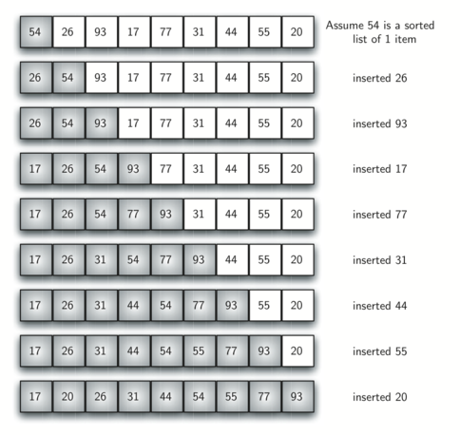
Insertion Sort - Example

Slide 18

Insertion Sort: Complexity Analysis
Case 1: If the input list is already in sorted order
Number of comparisons: Number of comparison in each iteration is 1.
Number of movement: No data movement takes place in any iteration.
$$M\left(n\right)=0$$
$C\left(n\right)=1+1+1+…+1$upto (n-1)^{th} iteration.

Slide 19
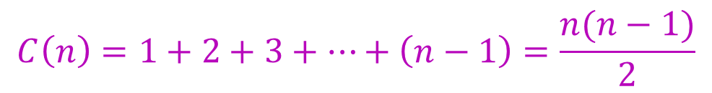

Insertion Sort: Complexity analysis
Case 2: If the input list is sorted but in reverse order
Number of comparisons: Number of comparison in each iteration is 1.
Number of movement: Number of movements takes place in any i^{th} iteration is i.
$$M\left(n\right)=1+2+3+…+\left(n−1\right)=\frac{n(n−1)}{2}$$
$$C\left(n\right)=1+2+3+…+\left(n−1\right)=\frac{n(n−1)}{2}$$

Slide 20

Insertion Sort: Complexity analysis
Case 3: If the input list is in random order
Let $p_{j}$be the probability that the key will go to the $jth$location
$(1≤j≤i+1)$.Then the number of comparisons will be ${j∙p}_{j}$.
The average number of comparisons in the $(i+1)th$iteration is
$$A_{i+1}=\sum_{j=1}^{i+1}{j∙p_{j}}$$
Assume that all keys are distinct and all permutations of keys are equally likely.
$$p_{1}=p_{2}=p_{3}=…=p_{i+1}=\frac{1}{i+1}$$

Slide 21

Insertion Sort: Complexity analysis
Case 3: Number of comparisons
Therefore, the average number of comparisons in the $(i+1)th$iteration
$$A_{i+1}=\frac{1}{i+1}\sum_{j=1}^{i+1}{j}=\frac{1}{i+1}∙\frac{\left(i+1\right)∙\left(i+2\right)}{2}=\frac{i+2}{2}$$
Total number of comparisons for all $(n−1)$iterations is
$$C\left(n\right)=\sum_{i=0}^{n−1}{A_{i+1}}=\frac{1}{2}∙\frac{n\left(n−1\right)}{2}+(n−1)$$

Slide 22

Insertion Sort: Complexity analysis
Case 3: Number of Movements
On the average, number of movements in the $ith$iteration
$$M_{i}=\frac{i+\left(i−1\right)+\left(i−2\right)+…+2+1}{i}=\frac{i+1}{2}$$
Total number of movements
$$M\left(n\right)=\sum_{i=1}^{n−1}{M_{i}}=\frac{1}{2}∙\frac{n\left(n−1\right)}{2}+\frac{n−1}{2}$$

Slide 23
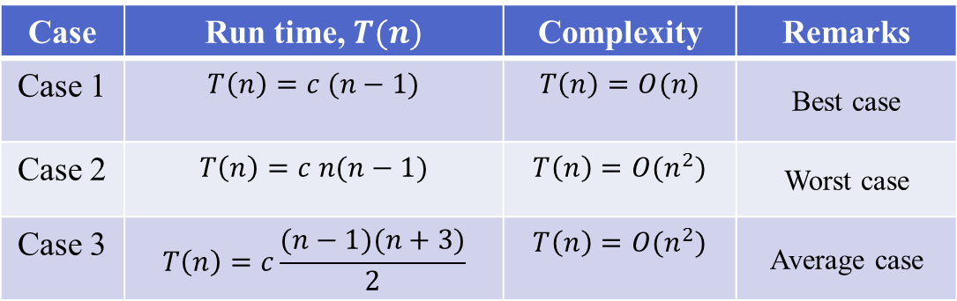
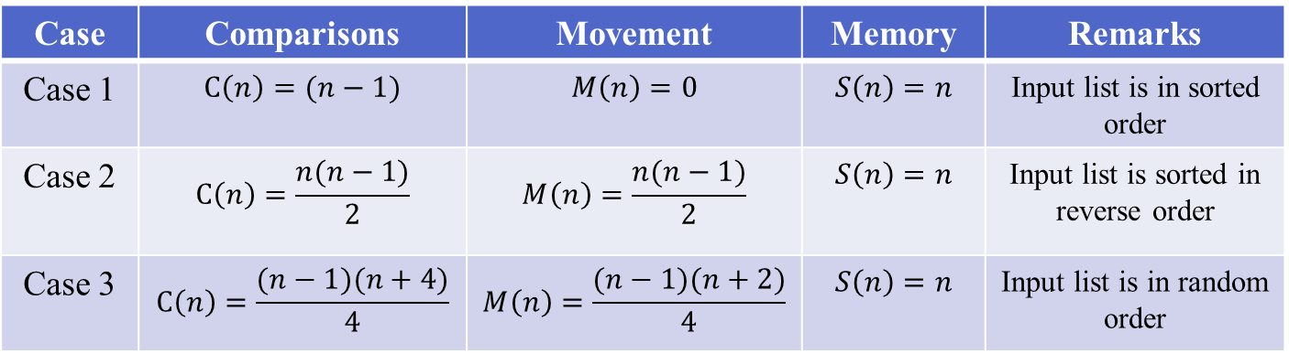
Insertion Sort: Summary of Complexity Analysis
Case | Comparisons | Movement | Memory | Remarks
Case 1 | $$C\left(n\right)=(n−1)$$ | $$M\left(n\right)=0$$ | $$S\left(n\right)=n$$ | Input list is in sorted order
Case 2 | $$C\left(n\right)=\frac{n(n−1)}{2}$$ | $$M\left(n\right)=\frac{n(n−1)}{2}$$ | $$S\left(n\right)=n$$ | Input list is sorted in reverse order
Case 3 | $$C\left(n\right)=\frac{(n−1)(n+4)}{4}$$ | $$M\left(n\right)=\frac{(n−1)(n+2)}{4}$$ | $$S\left(n\right)=n$$ | Input list is in random order
Case | Run time,$T(n)$ | Complexity | Remarks
Case 1 | $$T\left(n\right)=c (n−1)$$ | $$T\left(n\right)=O(n)$$ | Best case
Case 2 | $$T\left(n\right)=c n(n−1)$$ | $$T\left(n\right)=O(n^{2})$$ | Worst case
Case 3 | $$T\left(n\right)=c\frac{(n−1)(n+3)}{2}$$ | $$T\left(n\right)=O(n^{2})$$ | Average case

Slide 24
Selection Sort

Slide 25
Selection Sort
General situation :
0
k
size-1
x:
smallest elements, sorted
remainder, unsorted
Steps :
Find smallest element, mval, in x[k…size-1]
Swap smallest element with x[k], then increase k.
0
k
mval
size-1
x:
swap

Slide 26
Selection Sort
/* Yield location of smallest element in
x[k .. size-1];*/
int findMinLloc (int x[ ], int k, int size)
{
int j, pos; /* x[pos] is the smallest element found so far */
pos = k;
for (j=k+1; j<size; j++)
if (x[j] < x[pos])
pos = j;
return pos;
}

Slide 27
Selection Sort
/* The main sorting function */
/* Sort x[0..size-1] in non-decreasing order */
int selectionSort (int x[], int size)
{ int k, m;
for (k=0; k<size-1; k++)
{
m = findMinLoc(x, k, size);
temp = a[k];
a[k] = a[m];
a[m] = temp;
}
}

Slide 28
Selection Sort - Example
x:
3
12
-5
6
142
21
-17
45
x:
-17
-5
3
6
12
21
142
45
x:
-17
12
-5
6
142
21
3
45
x:
-17
-5
3
6
12
21
45
142
x:
-17
-5
12
6
142
21
3
45
x:
-17
-5
3
6
12
21
45
142
x:
-17
-5
3
6
142
21
12
45
x:
-17
-5
3
6
142
21
12
45
x:
-17
-5
3
6
12
21
142
45

Slide 29

Selection Sort: Complexity Analysis
Case 1: If the input list is already in sorted order
Number of comparisons:
$$C\left(n\right)=\sum_{i=1}^{n−1}{\left(n−i\right)= }\frac{n(n−1)}{2}$$
Number of movement: no data movement takes place in any iteration.
$$M\left(n\right)=0$$

Slide 30
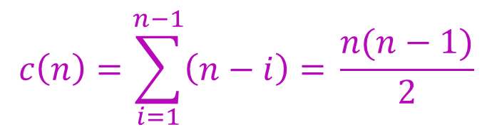

Selection Sort: Complexity Analysis
Case 2: If the input list is sorted but in reverse order
Number of comparisons:
Number of movements:
$$M\left(n\right)=\frac{3}{2}(n−1)$$
$$c\left(n\right)=\sum_{i=1}^{n−1}{\left(n−i\right)= }\frac{n(n−1)}{2}$$

Slide 31

Selection Sort: Complexity Analysis
Case 3: If the input list is in random order
Number of comparisons:
$$C\left(n\right)=\frac{n(n−1)}{2}$$
Let $p_{i}$be the probability that the $ith$smallest element is in the $ith$ position. Number of total swap operations$=(1−p_{i})×(n−1)$
where$p_{1}=p_{2}=p_{3}=…=p_{n}=\frac{1}{n}$
Total number of movements
$$M\left(n\right)=\left(1−\frac{1}{n}\right)×\left(n−1\right)×3=\frac{3(n−1)(n−1)}{n}$$

Slide 32
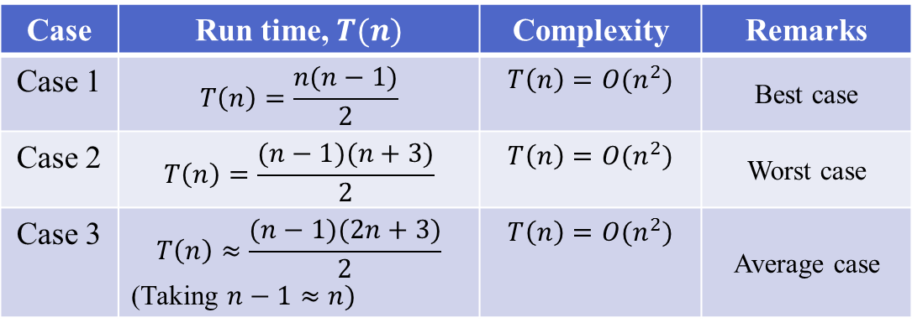
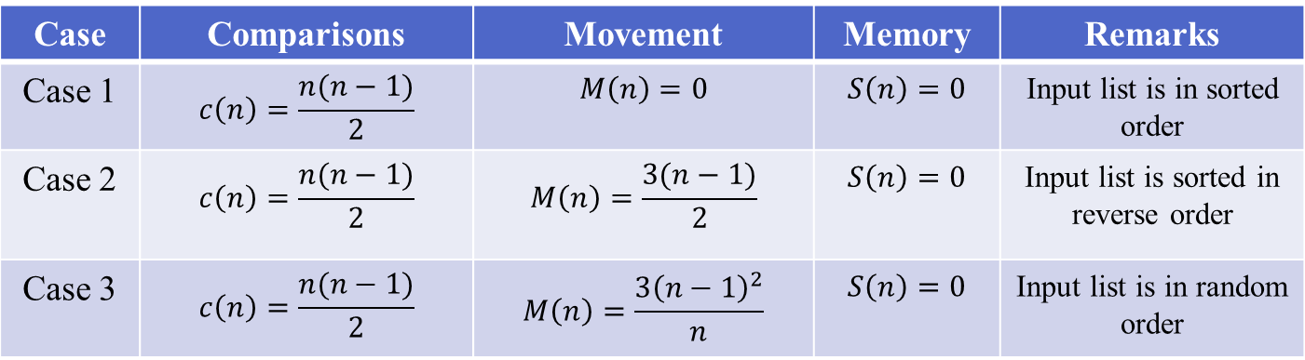
Selection Sort: Summary of Complexity analysis
Case | Comparisons | Movement | Memory | Remarks
Case 1 | $$c\left(n\right)=\frac{n(n−1)}{2}$$ | $$M\left(n\right)=0$$ | $$S\left(n\right)=0$$ | Input list is in sorted order
Case 2 | $$c\left(n\right)=\frac{n(n−1)}{2}$$ | $$M\left(n\right)=\frac{3(n−1)}{2}$$ | $$S\left(n\right)=0$$ | Input list is sorted in reverse order
Case 3 | $$c\left(n\right)=\frac{n(n−1)}{2}$$ | $$M\left(n\right)=\frac{{3\left(n−1\right)}^{2}}{n}$$ | $$S\left(n\right)=0$$ | Input list is in random order
Case | Run time,$T(n)$ | Complexity | Remarks
Case 1 | $$T\left(n\right)=\frac{n(n−1)}{2}$$ | $$T\left(n\right)=O(n^{2})$$ | Best case
Case 2 | $$T\left(n\right)=\frac{(n−1)(n+3)}{2}$$ | $$T\left(n\right)=O(n^{2})$$ | Worst case
Case 3 | $$T\left(n\right)≈\frac{(n−1)(2n+3)}{2}$$ (Taking$n−1≈n)$ | $$T\left(n\right)=O(n^{2})$$ | Average case

Slide 33
Bubble Sort

Slide 34
Bubble Sort
In every iteration heaviest element drops at the bottom.
The sorting process proceeds in several passes.
In every pass we go on comparing neighbouring pairs, and swap them if out of order.
In every pass, the largest of the elements under considering will bubble to the top (i.e., the right).
The bottom moves upward.

Slide 35
Bubble Sort
How the passes proceed?
In pass 1, we consider index 0 to n-1.
In pass 2, we consider index 0 to n-2.
In pass 3, we consider index 0 to n-3.
……
……
In pass n-1, we consider index 0 to 1.

Slide 36
Bubble Sort - Example
Pass: 1
x:
3
12
-5
6
72
21
-7
45
x:
3
-5
6
12
72
21
-7
45
x:
3
12
-5
6
72
21
-7
45
x:
3
-5
6
12
21
72
-7
45
x:
3
-5
12
6
72
21
-7
45
x:
3
-5
6
12
21
-7
72
45
x:
3
-5
6
12
72
21
-7
45
x:
3
-5
6
12
21
-7
45
72

Slide 37
Bubble Sort - Example
Pass: 2
x:
3
-5
6
12
21
-7
45
72
x:
-5
3
6
12
21
-7
45
72
x:
-5
3
6
12
21
-7
45
72
x:
-5
3
6
12
-7
21
45
72
x:
-5
3
6
12
21
-7
45
72
x:
-5
3
6
12
-7
21
45
72
x:
-5
3
6
12
21
-7
45
72

Slide 38
Bubble Sort
void swap(int *x, int *y)
{
int tmp = *x;
*x = *y;
*y = tmp;
}
void bubble_sort(int x[], int n)
{
int i,j;
for (i=n-1; i>0; i--)
for (j=0; j<i; j++)
if (x[j] > x[j+1])
swap(&x[j],&x[j+1]);
}

Slide 39
Bubble Sort
int main()
{
int x[ ]={-45,89,-65,87,0,3,-23,19,56,21,76,-50};
int i;
for(i=0;i<12;i++)
printf("%d ",x[i]);
printf("\n");
bubble_sort(x,12);
for(i=0;i<12;i++)
printf("%d ",x[i]);
printf("\n");
}
OUTPUT
-45 89 -65 87 0 3 -23 19 56 21 76 -50
-65 -50 -45 -23 0 3 19 21 56 76 87 89

Slide 40

Bubble Sort: Complexity analysis
Case 1: If the input list is already in sorted order
Number of comparisons:
$$C\left(n\right)=\frac{n(n−1)}{2}$$
Number of movements:
$$M\left(n\right)=0$$

Slide 41
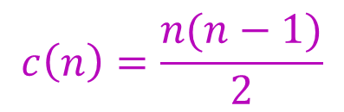

Bubble Sort: Complexity analysis
Case 2: If the input list is sorted but in reverse order
Number of comparisons:
Number of movements:
$$M\left(n\right)=\frac{n(n−1)}{2}$$
$$c\left(n\right)=\frac{n(n−1)}{2}$$

Slide 42

Bubble Sort: Complexity analysis
Case 3: If the input list is in random order
Number of comparisons:
$$C\left(n\right)=\frac{n(n−1)}{2}$$
Number of movements:
Let $p_{j}$be the probability that the largest element is in the unsorted part is in $jth$$(1≤j≤n−i+1)$ location.
The average number of swaps in the $ith$pass is
$$=\sum_{j=1}^{n−i+1}{\left(\overline{n−i+1}−j\right)}∙p_{j}$$

Slide 43

Bubble Sort: Complexity analysis
Case 3: If the input list is in random order
Number of movements:
$p_{1}=p_{2}=p_{n−i+1}=\frac{1}{n−i+1}$
Therefore, the average number of swaps in the $ith$pass is
$$=\sum_{j=1}^{n−i+1}{\frac{1}{n−i+1}∙\left(\overline{n−i+1}−j\right)}=\frac{n−i}{2}$$
The average number of movements
$$M(n)=\sum_{i=1}^{n−1}{\frac{n−i}{2}=\frac{n(n−1)}{4}}$$

Slide 44
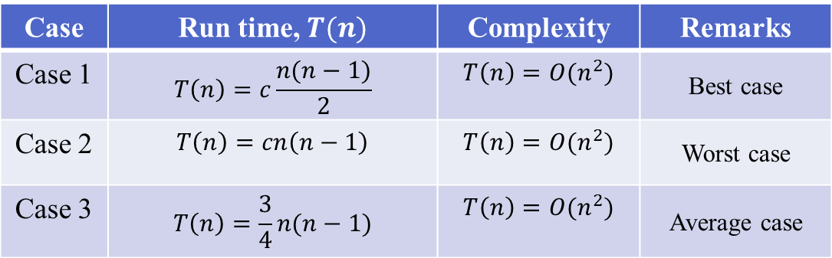
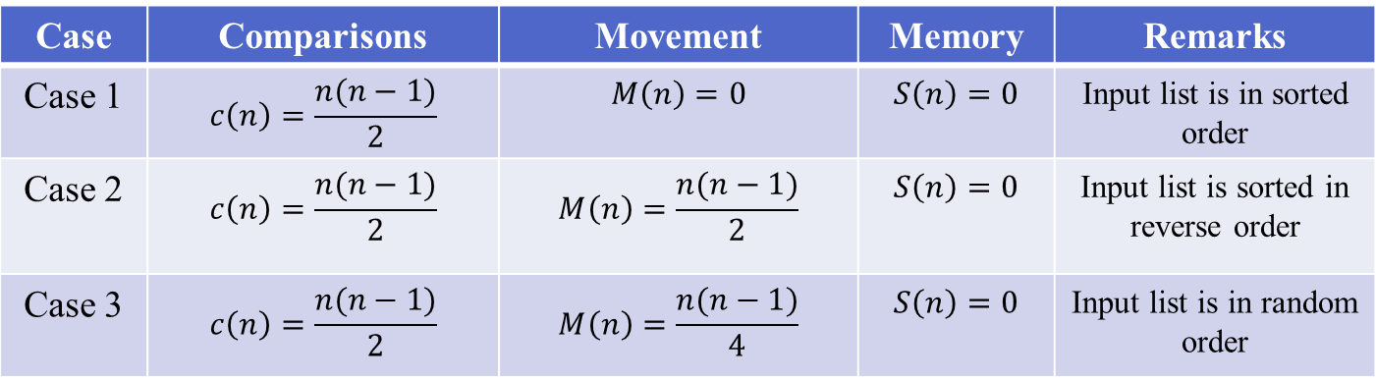
Bubble Sort: Summary of Complexity analysis
Case | Comparisons | Movement | Memory | Remarks
Case 1 | $$c\left(n\right)=\frac{n(n−1)}{2}$$ | $$M\left(n\right)=0$$ | $$S\left(n\right)=0$$ | Input list is in sorted order
Case 2 | $$c\left(n\right)=\frac{n(n−1)}{2}$$ | $$M\left(n\right)=\frac{n(n−1)}{2}$$ | $$S\left(n\right)=0$$ | Input list is sorted in reverse order
Case 3 | $$c\left(n\right)=\frac{n(n−1)}{2}$$ | $$M\left(n\right)=\frac{n(n−1)}{4}$$ | $$S\left(n\right)=0$$ | Input list is in random order
Case | Run time,$T(n)$ | Complexity | Remarks
Case 1 | $$T\left(n\right)=c\frac{n(n−1)}{2}$$ | $$T\left(n\right)=O(n^{2})$$ | Best case
Case 2 | $$T\left(n\right)=cn\left(n−1\right)$$ | $$T\left(n\right)=O(n^{2})$$ | Worst case
Case 3 | $$T\left(n\right)=\frac{3}{4}n(n−1)$$ | $$T\left(n\right)=O(n^{2})$$ | Average case

Slide 45
Bubble Sort
How do you make best case with (n-1) comparisons only?
By maintaining a variable flag, to check if there has been any swaps in a given pass.
If not, the array is already sorted.

Slide 46
Bubble Sort
void bubble_sort(int x[], int n)
{
int i,j;
int flag = 0;
for (i=n-1; i>0; i--)
{
for (j=0; j<i; j++)
if (x[j] > x[j+1])
{
swap(&x[j],&x[j+1]);
flag = 1;
}
if (flag == 0) return;
}
}

Slide 47
Efficient Sorting algorithms
Two of the most popular sorting algorithms are based on divide-and-conquer approach.
Quick sort
Merge sort
Basic concept of divide-and-conquer method:
sort (list)
{
if the list has length greater than 1
{
Partition the list into lowlist and highlist;
sort (lowlist);
sort (highlist);
combine (lowlist, highlist);
}
}

Slide 48
Quick Sort

Slide 49
Quick Sort – How it Works?
At every step, we select a pivot element in the list (usually the first element).
We put the pivot element in the final position of the sorted list.
All the elements less than or equal to the pivot element are to the left.
All the elements greater than the pivot element are to the right.

Slide 50
Quick Sort Partitioning
0
size-1
x:
pivot
Values smaller
Values greater
Perform
partitioning
Perform
partitioning

Slide 51
Quick Sort
#include <stdio.h>
void quickSort( int[], int, int);
int partition( int[], int, int);
void main()
{
int i,a[] = { 7, 12, 1, -2, 0, 15, 4, 11, 9};
printf("\n\nUnsorted array is: ");
for(i = 0; i < 9; ++i)
printf(" %d ", a[i]);
quickSort( a, 0, 8);
printf("\n\nSorted array is: ");
for(i = 0; i < 9; ++i)
printf(" %d ", a[i]);
}
void quickSort( int a[], int l, int r)
{
int j;
if( l < r ) { // divide and conquer
j = partition( a, l, r);
quickSort( a, l, j-1);
quickSort( a, j+1, r);
}
}

Slide 52
Quick Sort
int partition( int a[], int l, int r)
{
int pivot, i, j, t;
pivot = a[l];
i = l;
j = r+1;
while( 1) {
do {
++i;
} while(a[i]<=pivot && i<=r);
do {
--j;
} while( a[j] > pivot );
if( i >= j ) break;
t = a[i];
a[i] = a[j];
a[j] = t;
}
t = a[l];
a[l] = a[j];
a[j] = t;
return j;
}

Slide 53
Quick Sort - Example
Input: 45 -56 78 90 -3 -6 123 0 -3 45 69 68
45 -56 78 90 -3 -6 123 0 -3 45 69 68
-6 -56 -3 0 -3
45
123 90 78 45 69 68
-56
-6
-3 0 -3
123
68 90 78 45 69
-3
0 -3
45
68
78 90 69
-3
0
69
78
90
Output: -56 -6 -3 -3 0 45 45 68 69 78 90 123

Slide 54

Quick Sort: Complexity analysis
Memory requirement:
Size of the stack is:
$$S\left(n\right)=\left\lceil \log_{2 }n\right\rceil +1$$
Number of comparisons:
Let, $T(n)$represents total time to sort n elements and $P(n)$represents the time for perform a partition of a list of $n$elements.
$T\left(n\right)=P\left(n\right)+T\left(n_{l}\right)+T\left(n_{r}\right)$, with$T\left(1\right)=T\left(0\right)=0$
where, $n_{l}$ = number of elements in the left sub list
$n_{r}$ = number of elements in the right sub list and $0 ≤ n_{l}$, $n_{r}<n$

Slide 55

Quick Sort: Complexity analysis
Case 1: Elements in the list are in ascending order
Number of comparisons:
$C\left(n\right)=n−1+C\left(n−1\right),$with$C\left(1\right)=$$C\left(0\right)=0$
$$C\left(n\right)=\left(n−1\right)+\left(n−2\right)+\left(n−3\right)+…+2+1$$
$$C\left(n\right)=\frac{n(n−1)}{2}$$
Number of movements:
$$M\left(n\right)=0$$

Slide 56
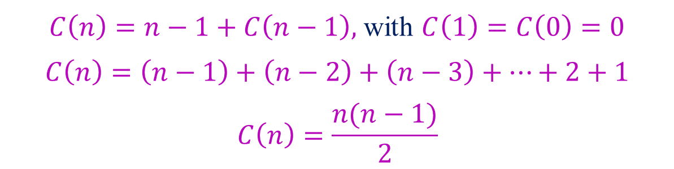

Quick Sort: Complexity analysis
Case 2: Elements in the list are in reverse order
Number of comparisons:
Number of movements:
$$M\left(n\right)=\left\{\begin{aligned}\frac{n−1}{2}, if n is odd \\ \frac{n}{2}, if n is even \end{aligned}\right.$$
$C\left(n\right)=n−1+C\left(n−1\right),$with$C\left(1\right)=$$C\left(0\right)=0$
$$C\left(n\right)=\left(n−1\right)+\left(n−2\right)+\left(n−3\right)+…+2+1$$
$$C\left(n\right)=\frac{n(n−1)}{2}$$

Slide 57


Quick Sort: Complexity analysis
Case 3: Elements in the list are in random order
Number of comparisons:
$$C\left(n\right)=\left(n−1\right)+\sum_{i=1}^{n−1}{\frac{1}{n}}\left[C\left(i−1\right)+C(n−1)\right] with C\left(1\right)=C\left(0\right)=0$$
$$C\left(n\right)=\left(n−1\right)+\frac{2}{n}\sum_{i=1}^{n−1}{C(i)}$$
$$C\left(n\right)=2\left(n+1\right)\left(\log_{e}n+0.577\right)−4n$$
$ith$ location
(i-1)
(n-1)

Slide 58

Quick Sort: Complexity analysis
Case 3: Elements in the list are in random order
Number of movements:
$$M\left(n\right)=\frac{1}{n}\sum_{i=1}^{n}{\left[\left(i−1\right)+M\left(i−1\right)+M(n−i)\right]}$$
$$M\left(n\right)=\frac{n−1}{2}+\frac{2}{n}\sum_{i=1}^{n−1}{M(i)}$$
$$M\left(n\right)=2\left(n+1\right)\left(\log_{e}n+0.577\right)−4n$$

Slide 59
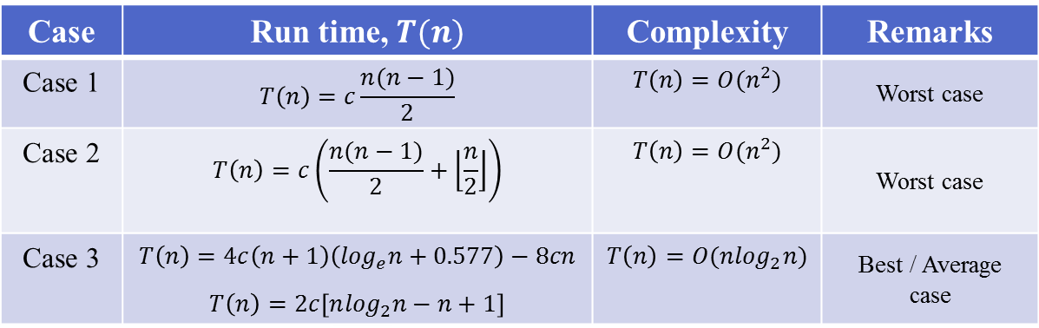
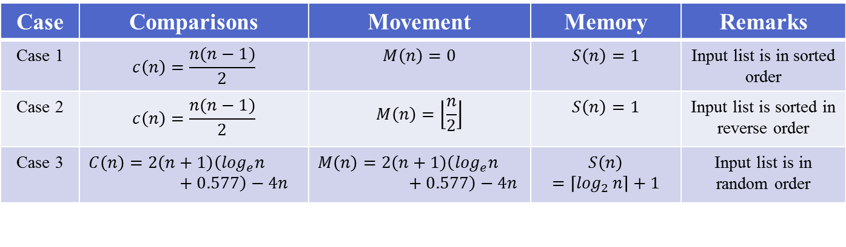
Quick Sort: Summary of Complexity analysis
Case | Comparisons | Movement | Memory | Remarks
Case 1 | $$c\left(n\right)=\frac{n(n−1)}{2}$$ | $$M\left(n\right)=0$$ | $$S\left(n\right)=1$$ | Input list is in sorted order
Case 2 | $$c\left(n\right)=\frac{n(n−1)}{2}$$ | $$M\left(n\right)=\left\lfloor \frac{n}{2}\right\rfloor$$ | $$S\left(n\right)=1$$ | Input list is sorted in reverse order
Case 3 | $$C\left(n\right)=2\left(n+1\right)\left(\log_{e}n+0.577\right)−4n$$ | $$M\left(n\right)=2\left(n+1\right)\left(\log_{e}n+0.577\right)−4n$$ | $$S\left(n\right)=\left\lceil \log_{2 }n\right\rceil +1$$ | Input list is in random order
Case | Run time,$T(n)$ | Complexity | Remarks
Case 1 | $$T\left(n\right)=c\frac{n(n−1)}{2}$$ | $$T\left(n\right)=O(n^{2})$$ | Worst case
Case 2 | $$T\left(n\right)=c\left(\frac{n(n−1)}{2}+\left\lfloor \frac{n}{2}\right\rfloor \right)$$ | $$T\left(n\right)=O(n^{2})$$ | Worst case
Case 3 | $$T\left(n\right)=4c\left(n+1\right)\left(\log_{e}n+0.577\right)−8cn$$ $$T\left(n\right)=2c\left[n\log_{2}n−n+1\right]$$ | $$T\left(n\right)=O(n\log_{2}n)$$ | Best / Average case

Slide 60
Merge Sort

Slide 61
Merge Sort – How it Works?
Input Array
Part-I
Part-II
Part-I
Part-II
Part-I
Part-II
Merge
Sorted arrays
Split

Slide 62



Merging two Sorted arrays
$$Pa$$
$$Pb$$
a:
Sorted Array
b:
Sorted Array
0
l
0
m
c:
Merged sorted array
0
l+m-1
Move and copy elements pointed by $Pa$ if its value is smaller
than the element pointed by $Pb$in $(l+m−1)$operations and otherwise.

Slide 63
Merge Sort – Example
x:
3
12
-5
6
72
21
-7
45
Splitting arrays
3
12
-5
6
72
21
-7
45
3
12
-5
6
72
21
-7
45
3
12
-5
6
72
21
-7
45
Merging two
sorted arrays
3
12
-5
6
21
72
-7
45
-5
3
6
12
-7
21
45
72
-7
-7
-5
-5
3
3
6
12
21
45
72

Slide 64
Merge Sort Program
#include<stdio.h>
void mergesort(int a[],int i,int j);
void merge(int a[],int i1,int j1,int i2,int j2);
int main()
{
int a[30],n,i;
printf("Enter no of elements:");
scanf("%d",&n);
printf("Enter array elements:");
for(i=0;i<n;i++)
scanf("%d",&a[i]);
mergesort(a,0,n-1);
printf("\nSorted array is :");
for(i=0;i<n;i++)
printf("%d ",a[i]);
return 0;
}

Slide 65
Merge Sort Program
void mergesort(int a[],int i,int j)
{
int mid;
if(i<j) {
mid=(i+j)/2;
/* left recursion */
mergesort(a,i,mid);
/* right recursion */
mergesort(a,mid+1,j);
/* merging of two sorted sub-arrays */
merge(a,i,mid,mid+1,j);
}
}

Slide 66
Merge Sort Program
void merge(int a[],int i1,int i2,int j1,int j2)
{
int temp[50]; //array used for merging
int i=i1,j=j1,k=0;
while(i<=i2 && j<=j2) //while elements in both lists
{
if(a[i]<a[j])
temp[k++]=a[i++];
else
temp[k++]=a[j++];
}
while(i<=i2) //copy remaining elements of the first list
temp[k++]=a[i++];
while(j<=j2) //copy remaining elements of the second list
temp[k++]=a[j++];
for(i=i1,j=0;i<=j2;i++,j++)
a[i]=temp[j]; //Transfer elements from temp[] back to a[]
}

Slide 67
Merge Sort – Splitting Trace
-56 23 43 -5 -3 0 123 -35 87 56 75 80
-56 23 43 -5 -3 0
123 -35 87 56 75 80
-56 23 43
-5 -3 0
123 -35 87
56 75 80
23 43
-3 0
123
-35 87
56
75 80
-56
-5
23
43
-3
0
-35
87
75
80
Output: -56 -35 -5 -3 0 23 43 56 75 80 87 123
Space Complexity??
Worst Case: O(n.log(n))

Slide 68

Merge Sort: Complexity analysis
Time Complexity:
$T\left(n\right)=D\left(n\right)+T\left(\left\lfloor \frac{n}{2}\right\rfloor \right)+T\left(\left\lceil \frac{n}{2}\right\rceil \right)+C\left(n\right) if n>1$
$T\left(n\right)=c_{1} if n=1$
For simplicity of calculation
$T\left(\left\lfloor \frac{n}{2}\right\rfloor \right)=T\left(\left\lceil \frac{n}{2}\right\rceil \right)=T\left(\frac{n}{2}\right)$
$T\left(n\right)=c_{1} if n=1$
$T\left(n\right)=c_{2}+2T\left(\frac{n}{2}\right)+\left(n−1\right) if n>1$
$T\left(n\right)=n∙c_{1}+n\log_{2}n+\left(c_{2}−1\right)\left(n−1\right) Assuming n=2^{k}$

Slide 69
Quick Sort vs. Merge Sort
Quick sort
hard division, easy combination
partition in the divide step of the divide-and-conquer framework
hence combine step does nothing
Merge sort
easy division, hard combination
merge in the combine step
the divide step in this framework does one simple calculation only

Slide 70
Quick Sort vs. Merge Sort
Both the algorithms divide the problem into two sub problems.
Merge sort:
two sub problems are of almost equal size always.
Quick sort:
an equal sub division is not guaranteed.
This difference between the two sorting methods appears as the deciding factor of their run time performances.

Slide 71

Any question?

